Slide 1
Router Configuration and Static Routing CS F303
Dr. Pranav M. Pawar

Slide 2
Packet Tracer
Packet Tracer is a program used to illustrate how computer networks work.
Packet Tracer has two different views
Logical Workspace
Physical Workspace
Packet Tracer also has two modes of operation
Realtime Mode
Simulation Mode

Slide 3
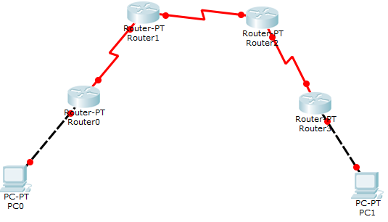
Practical Topology

Slide 4
Connections (need to modify)
Device | Connected from | Connected to | IP Address
PC0 | FastEthernet0 | Router0’s FastEthernet0/0 | 10.0.0.2
Router0 | FastEthernet0/0 | PC0’s FastEthernet0 | 10.0.0.1
Router0 | Serial 2/0 | Router1’s serial 2/0 | 192.168.0.253
Router1 | Serial 2/0 | Router0’s Serial 2/0 | 192.168.0.254
Router1 | Serial 3/0 | Router2’s Serial 3/0 | 192.168.0.249
Router2 | Serial 3/0 | Router1’s Serial 3/0 | 192.168.0.250
Router2 | Serial 2/0 | Router3’s Serial 2/0 | 192.168.0.245
Router3 | Serial 2/0 | Router2’s Serial 2/0 | 192.168.0.246
Router3 | FastEthernet 0/0 | PC1’s FastEthernet 0/0 | 20.0.0.1
PC1 | FastEthernet0 | Router1’s FastEthernet 0/0 | 20.0.0.2
IP address and Subnet Mask

Slide 5
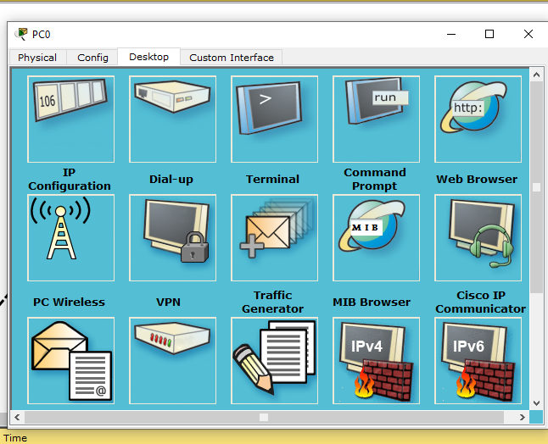
Assign IP Address PC (1)
Assign IP address to PC0.
Step 1: Click on PC0, we will get following window.

Slide 6
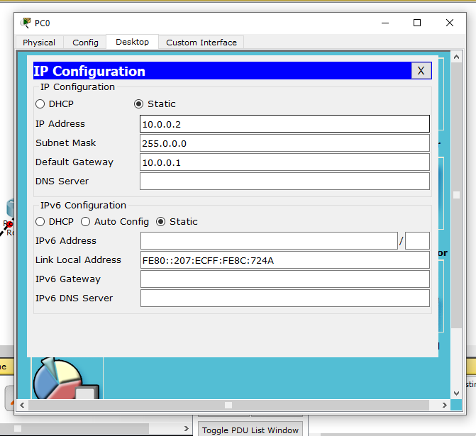
Assign IP Address PC (2)
Assign IP address to PC0.
Step 2: Click on IP configuration and set the IP address, subnet mask and gateway address.
Assign IP address to PC1 in same way.

Slide 7
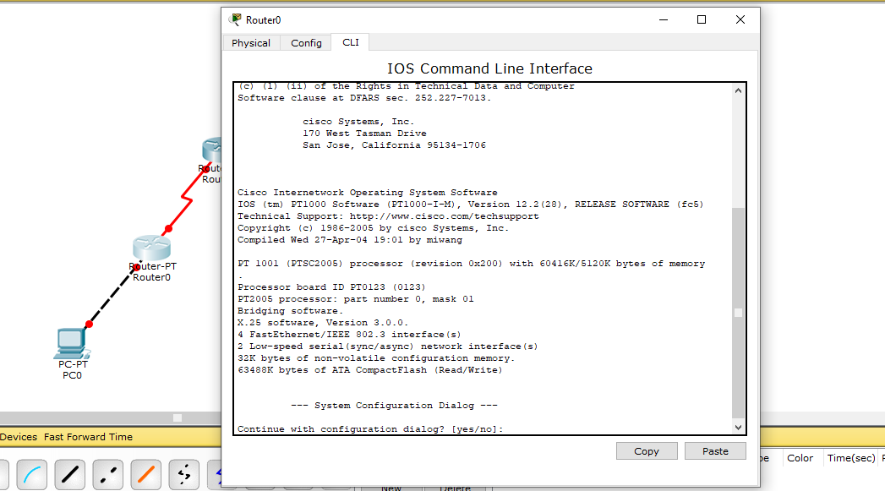
Configuring Router 0 (1)
Step1: Double click Router0 and click CLI and press Enter key to access the command prompt of Router0.
Press N in Continue with configuration dialog? [yes/no]:

Slide 8
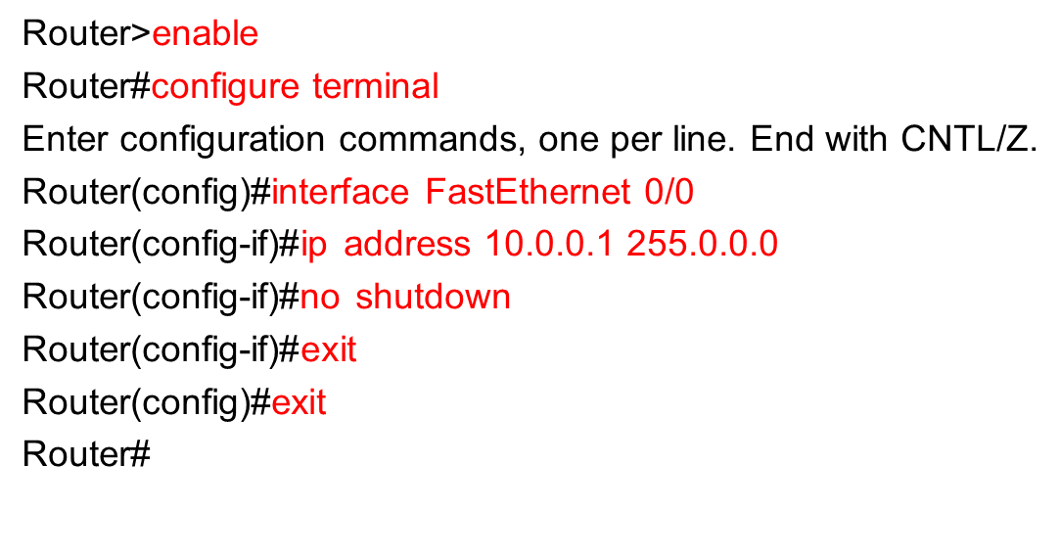
Configuring Router (2)
Step 2: Use following commands to configure Router 0, FastEthernet 0/0 interface.

Slide 9
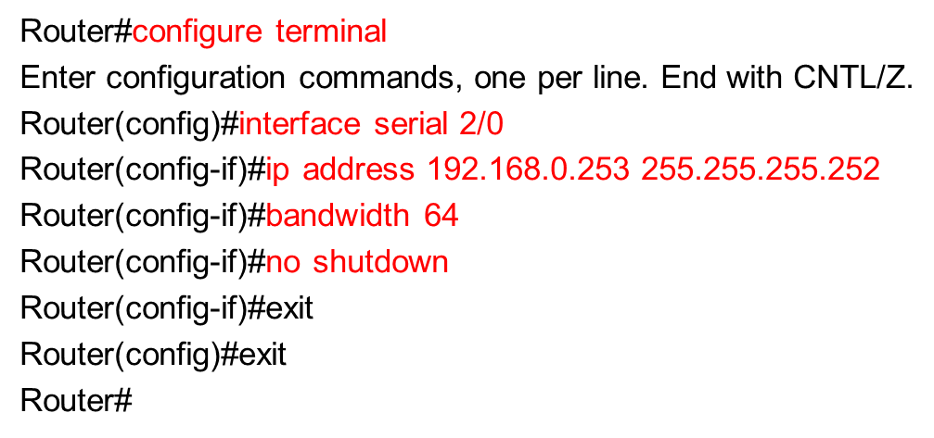
Configuring Router 0 (2)
Step 2: Use following commands to configure Router 0, Serial 2/0 interface.

Slide 10
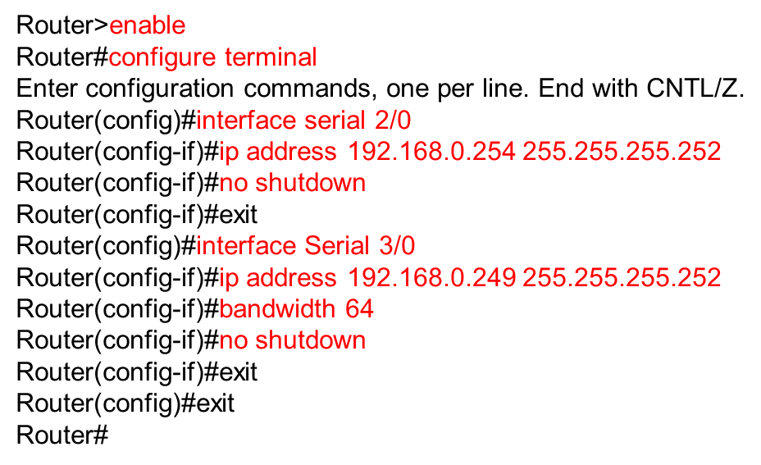
Configuring Router 1
Configure Serial 2/0 and Serial 3/0 interface of Router 1.

Slide 11
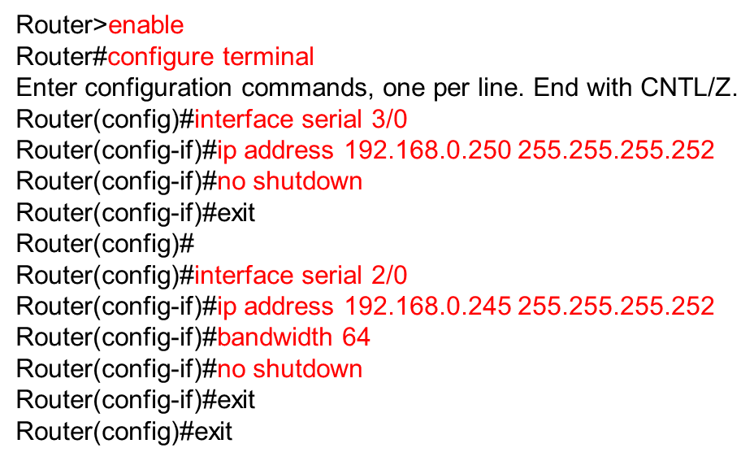
Configuring Router 2
Configure Serial 3/0 and Serial 2/0 interface of Router 2.

Slide 12
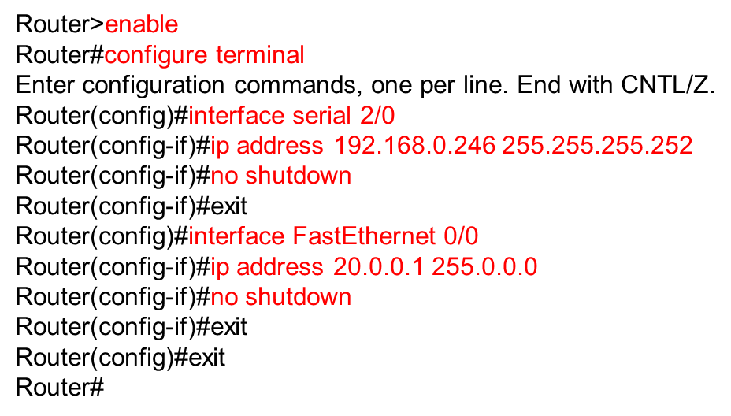
Configuring Router 3
Configure Serial 2/0 and FastEthernet 0/0 interface of Router 3.

Slide 13
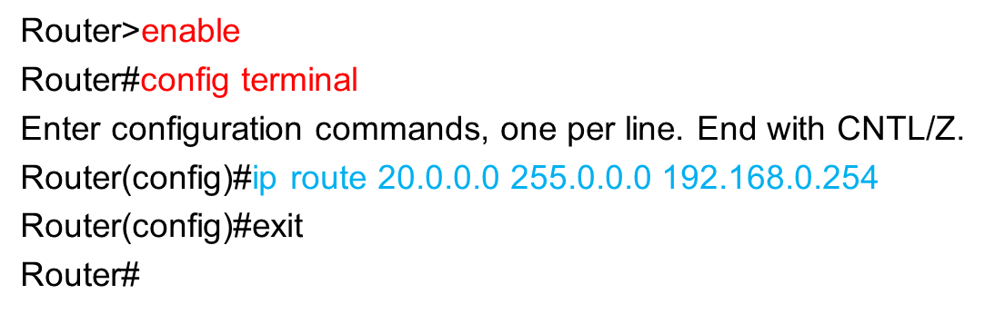
Configure Routing (1)
For Router 0: Instructs router that when you receive a packet for 20.0.0.0 network give it to 192.168.0.254.

Slide 14
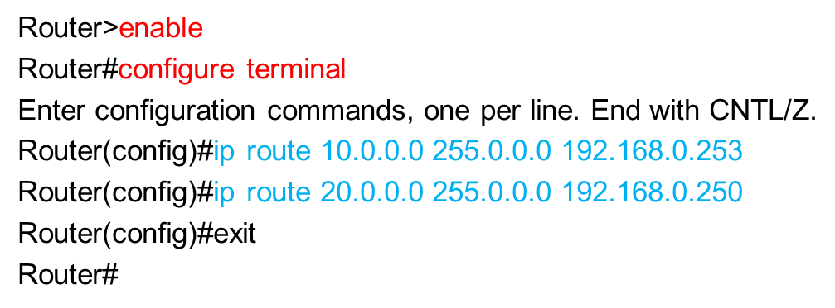
Configure Routing (2)
For Router 1: For this router both networks are reachable via other routers so we need to configure route for both networks 10.0.0.0 and 20.0.0.0.

Slide 15
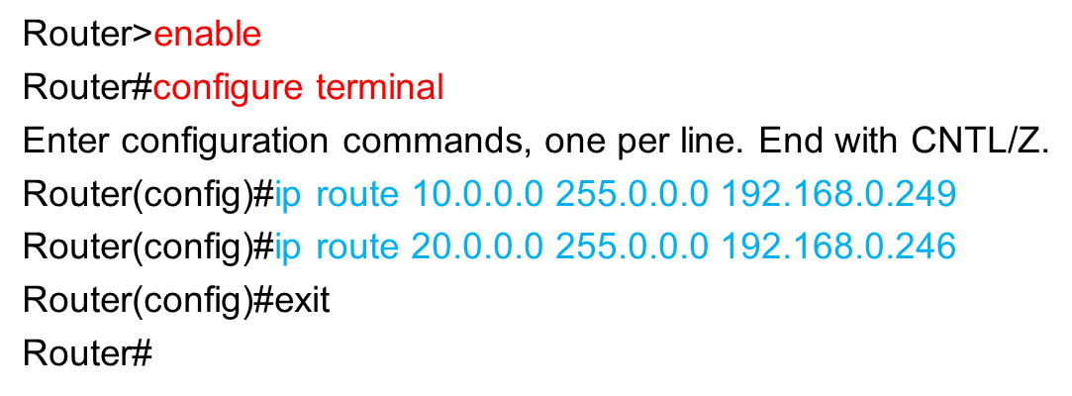
Configure Routing (3)
For Router 2: Here also we need too configure route for both networks on this router.

Slide 16
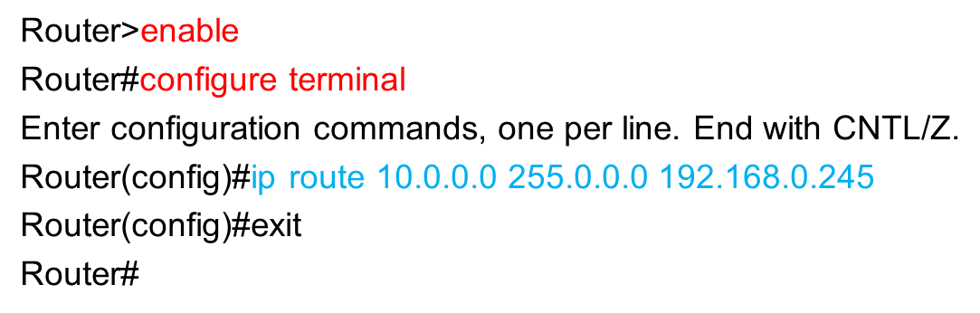
Configure Routing (3)
For Router 3: Network 20.0.0.0 is directly connected so we only need to configure network 10.0.0.0 on this router.

Slide 17
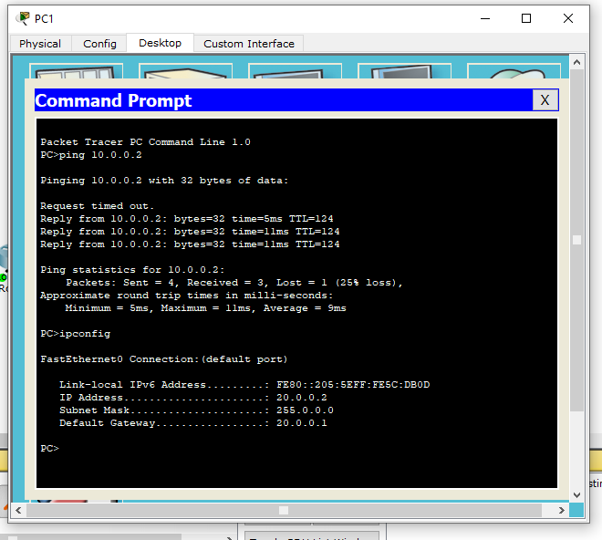
Ping from PC1 to PC0

Slide 18

Ping from PC0 to PC1

Slide 19
Thank You!

